Slide 1
Set up new site in Dreamweaver
Raymond Tsang
t-raymond.tsang@fevaworks.com

Slide 2
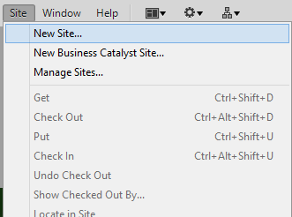
Site -> New site

Slide 3
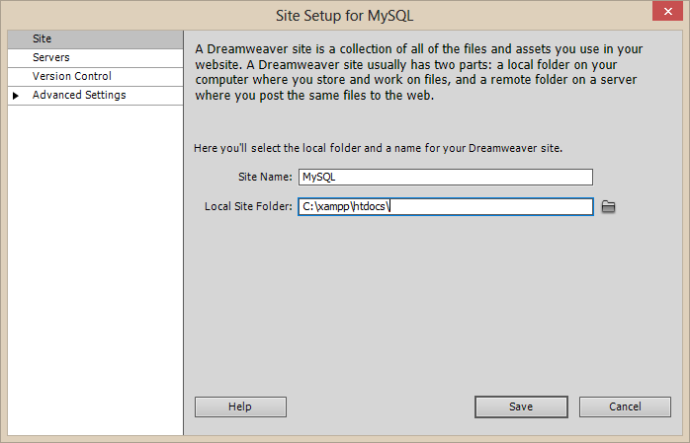
C:\xampp\htdocs\

Slide 4
Site
Site name: | MySQL
Local site folder: | C:\xampp\htdocs\

Slide 5
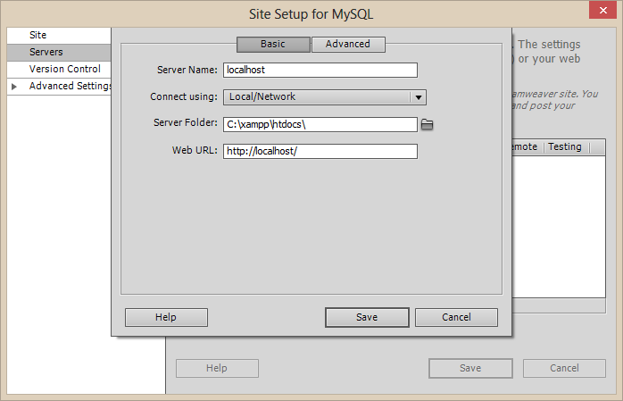
Left menu -> Servers

Slide 6
Server Basic
Server Name: | localhost
Connect using: | Local/Network
Server Folder: | C:\xampp\htdocs\
Web URL: | http://localhost/

Slide 7
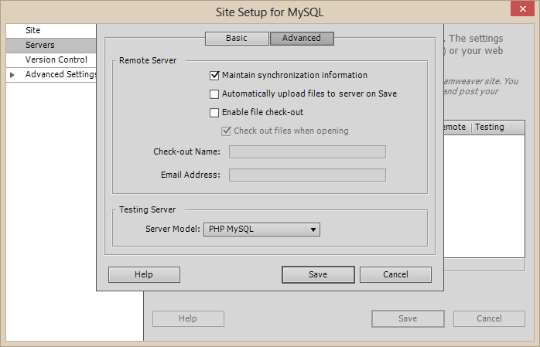
Server Advanced

Slide 8
Server Advanced
Server Model: PHP MySQL

Slide 9
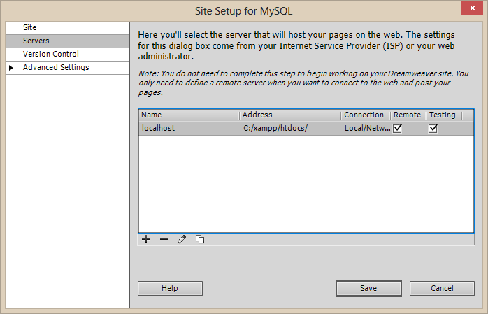
Tick Testing

Slide 10
Finished
Click Save
You can see your files in the Files panel.
Window -> Files

